Slide 1

Digital Integrated Circuits A Design Perspective
Jan M. Rabaey
Anantha Chandrakasan
Borivoje Nikolic
Design Methodologies
December 3, 2002

Slide 2
The Design Productivity Challenge
Logic Transistors per Chip (K)
Productivity (Trans./Staff-Month)
1981
1983
1985
1987
1989
1991
1993
1995
1997
1999
2001
2003
2005
2007
2009
A growing gap between design complexity and design productivity
Source: sematech97

Slide 3
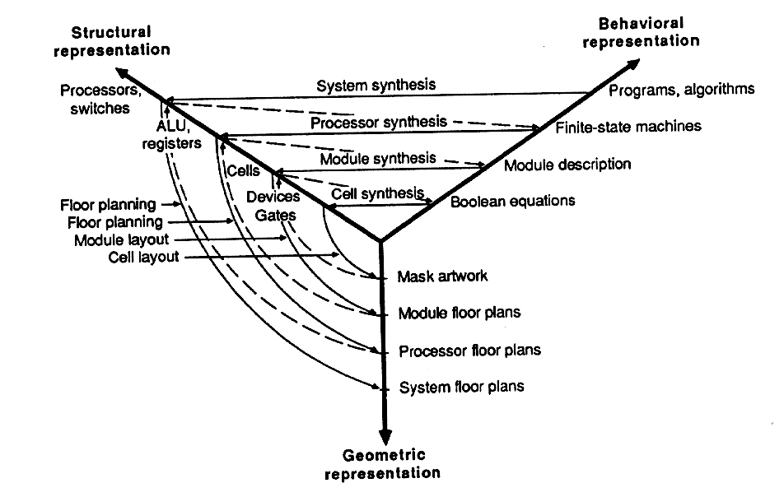
Design Methodology
Design process traverses iteratively between three abstractions: behavior, structure, and geometry
More and more automation for each of these steps

Slide 4
Design Analysis and Verification
Accounts for largest fraction of design time
More efficient when done at higher levels of abstraction - selection of correct analysis level can account for multiple orders of magnitude in verification time
Two major approaches:
Simulation
Verification

Slide 5
Digital Data treated as Analog Signal
Circuit Simulation
Both Time and Data treated as Analog Quantities
Also complicated by presence of non-linear elements
(relaxed in timing simulation)

Slide 6
Representing Data as Discrete Entity
Discretizing the data using
switching threshold
The linear switch model
of the inverter

Slide 7
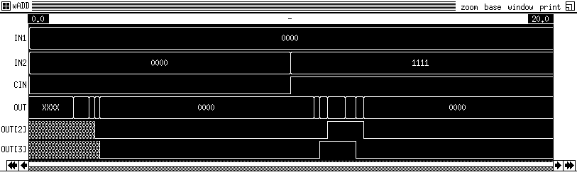
Circuit versus Switch-Level Simulation
Circuit
Switch

Slide 8
Structural Description of Accumulator
Design defined as composition of
register and full-adder cells (“netlist”)
Data represented as {0,1,Z}
Time discretized and progresses with
unit steps
Description language: VHDL
Other options: schematics, Verilog

Slide 9
Behavioral Description of Accumulator
Design described as set of input-output
relations, regardless of chosen
implementation
Data described at higher abstraction
level (“integer”)

Slide 10
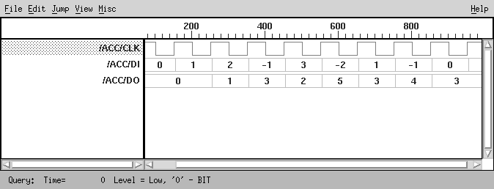
Behavioral simulation of accumulator
Discrete time
Integer data
(Synopsys Waves display tool)

Slide 11
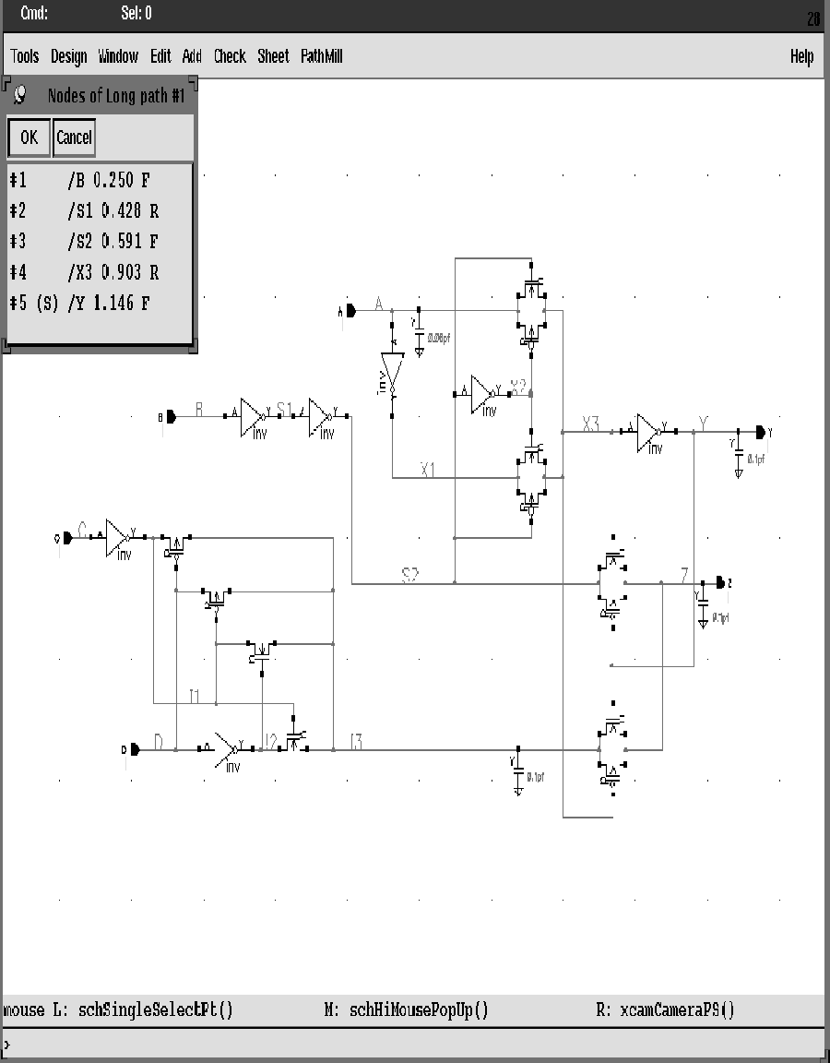
Timing Verification
Critical path
Enumerates and rank
orders critical timing paths
No simulation needed!
(Synopsys-Epic Pathmill)

Slide 12
Issues in Timing Verification
False Timing Paths

Slide 13
Implementation Methodologies

Slide 14
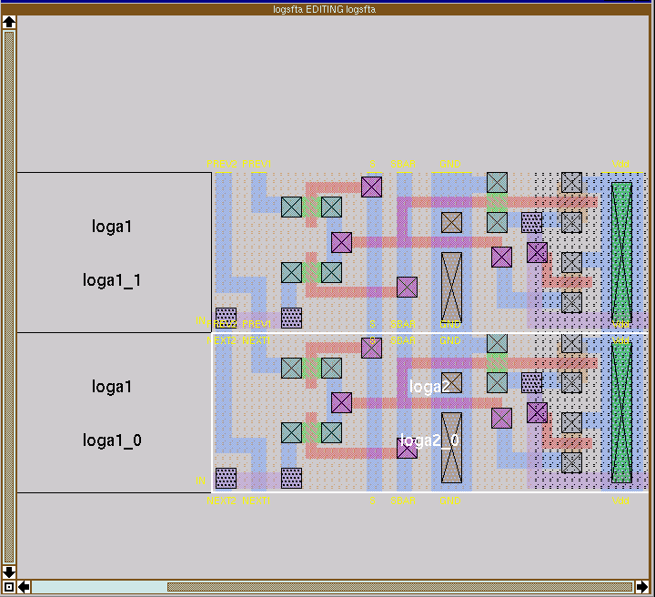
Custom Design – Layout Editor
Magic Layout Editor
(UC Berkeley)

Slide 15
Symbolic Layout
Dimensionless layout entities
Only topology is important
Final layout generated by “compaction” program
Stick diagram of inverter

Slide 16
Cell-based Design (or standard cells)
Routing channel
requirements are
reduced by presence
of more interconnect
layers

Slide 17
Standard Cell — Example
[Brodersen92]

Slide 18
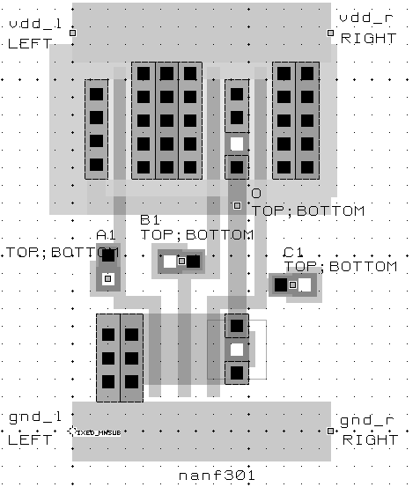
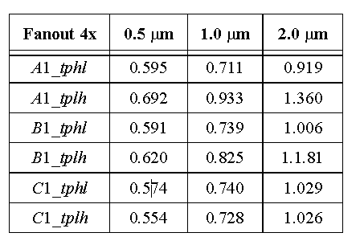
Standard Cell - Example
3-input NAND cell
(from Mississippi State Library)
characterized for fanout of 4 and
for three different technologies

Slide 19
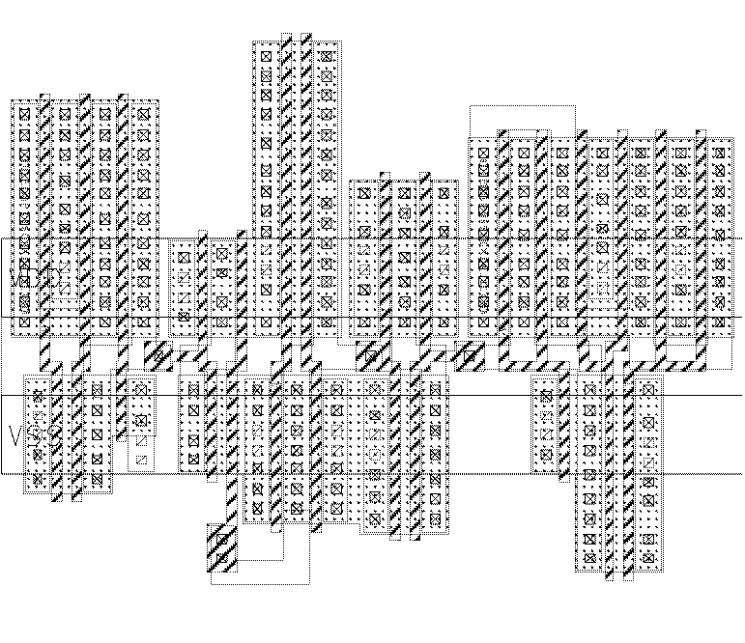
Automatic Cell Generation
Random-logic layout
generated by CLEO
cell compiler (Digital)

Slide 20
Module Generators — Compiled Datapath

Slide 21
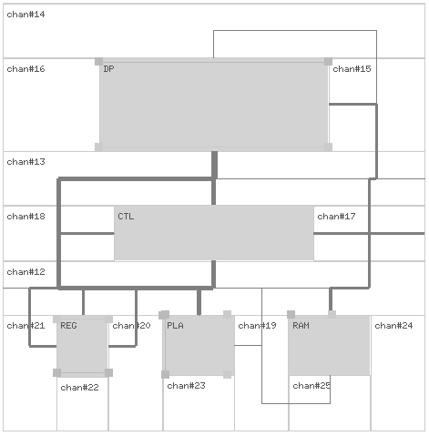
Macrocell Design Methodology
Macrocell
Floorplan:
Defines overall
topology of design,
relative placement of
modules, and global
routes of busses,
supplies, and clocks
Interconnect Bus
Routing Channel

Slide 22
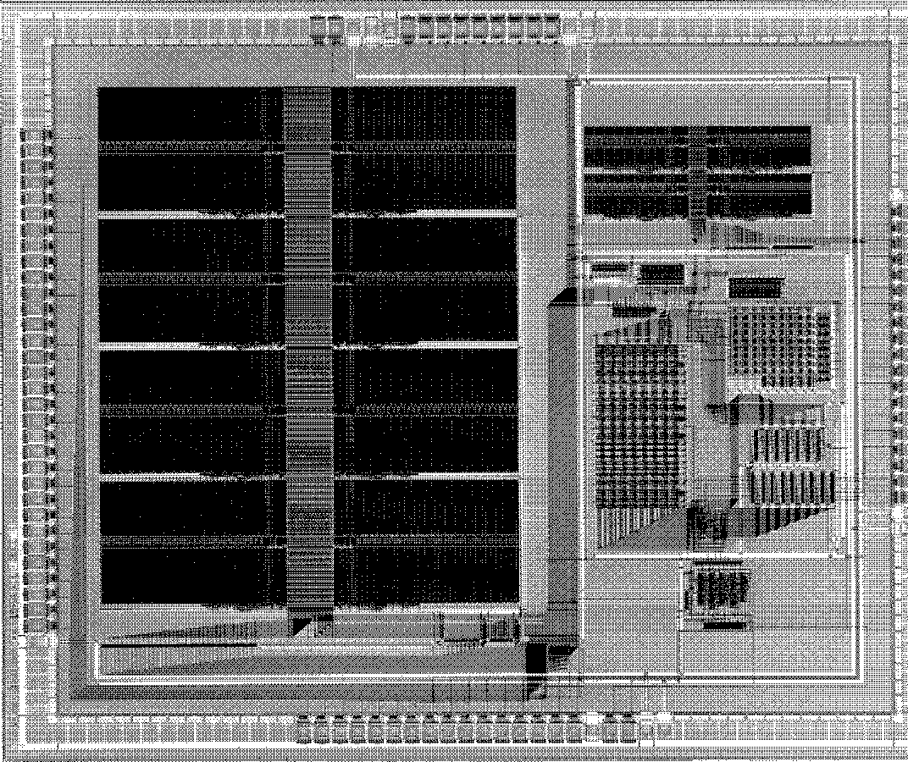
Macrocell-Based Design Example
SRAM
SRAM
Data paths
Routing Channel
Standard cells
Video-encoder chip
[Brodersen92]

Slide 23
Gate Array — Sea-of-gates
Uncommited
Cell
Committed
Cell (4-input NOR)

Slide 24
Sea-of-gate Primitive Cells
Using oxide-isolation
Using gate-isolation

Slide 25
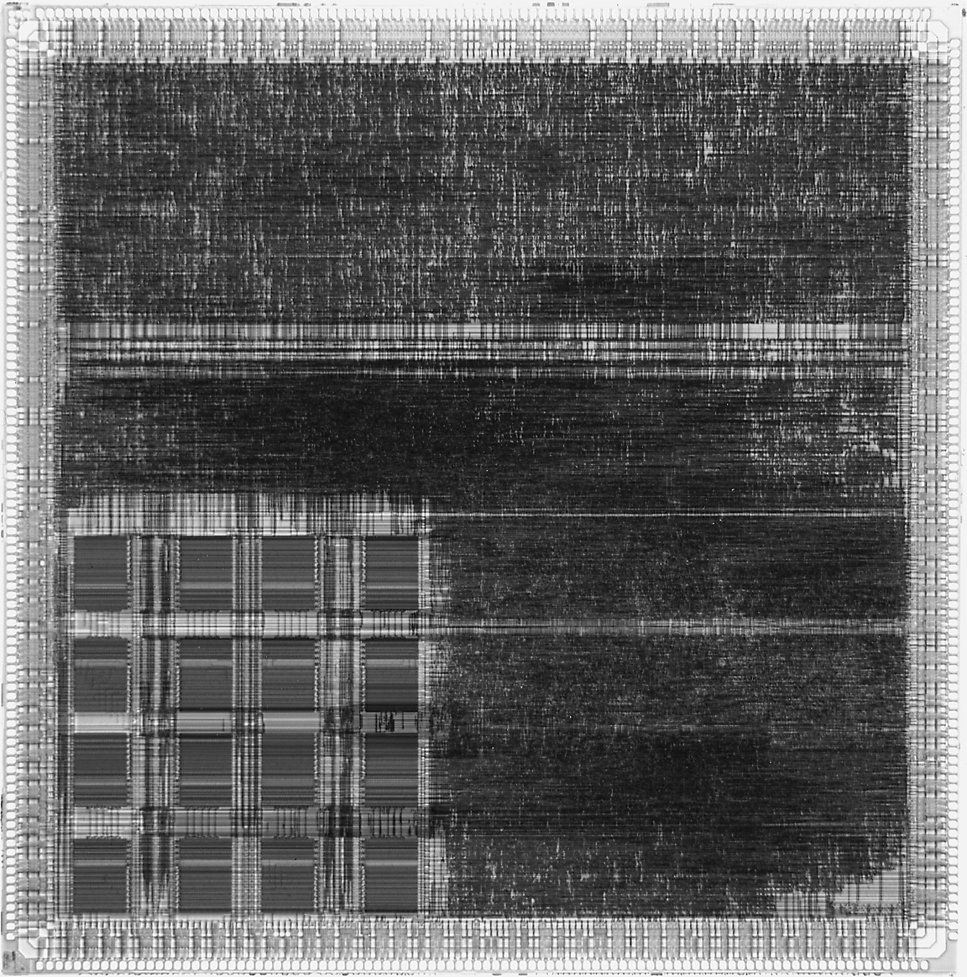
Sea-of-gates
Random Logic
Memory
Subsystem
LSI Logic LEA300K
(0.6 μm CMOS)

Slide 26
Prewired Arrays
Categories of prewired arrays (or field-programmable devices):
Fuse-based (program-once)
Non-volatile EPROM based
RAM based

Slide 27
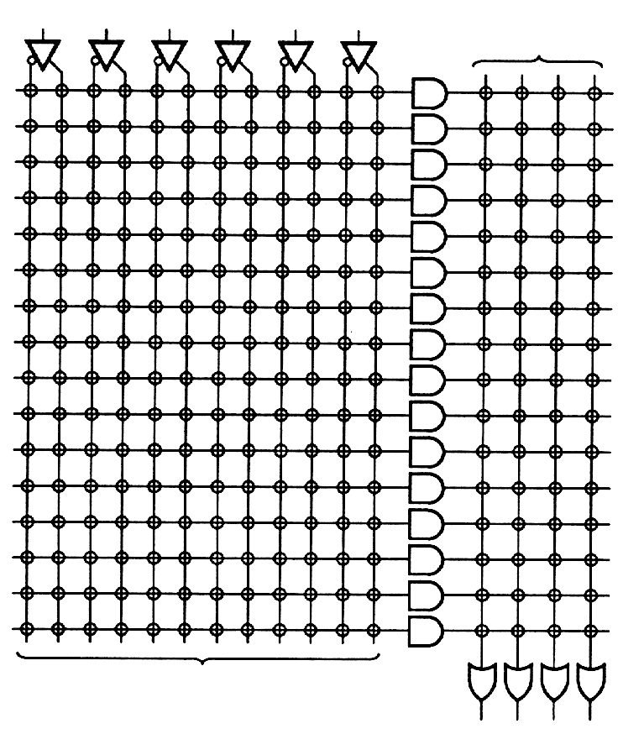
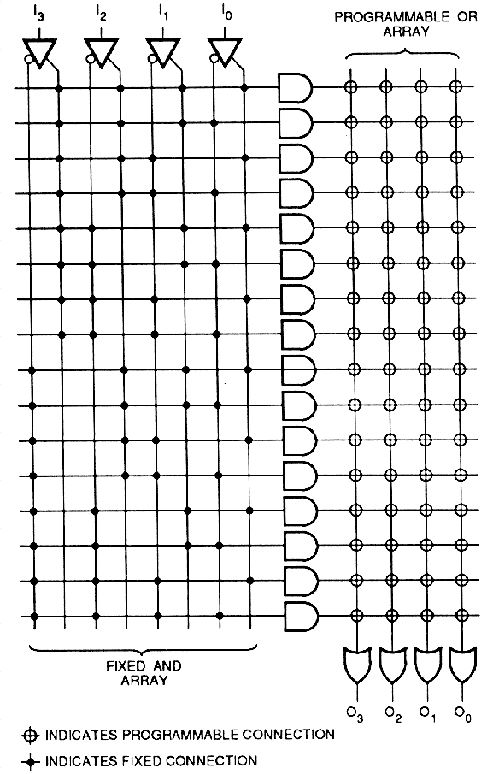
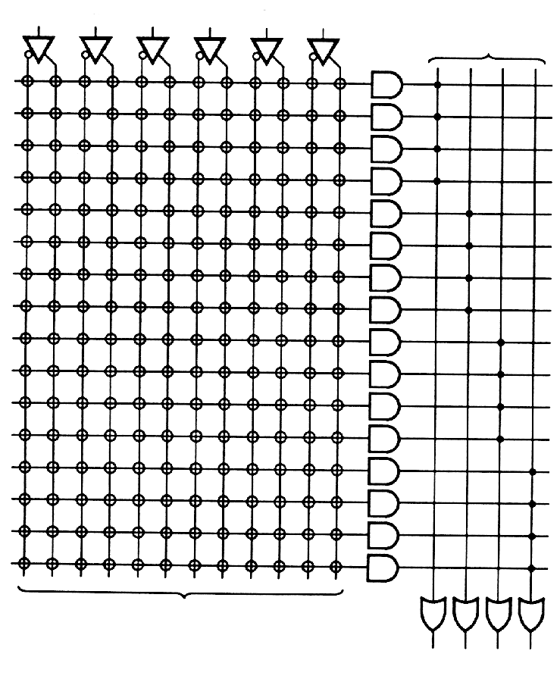
Programmable Logic Devices
PLA
PROM
PAL

Slide 28
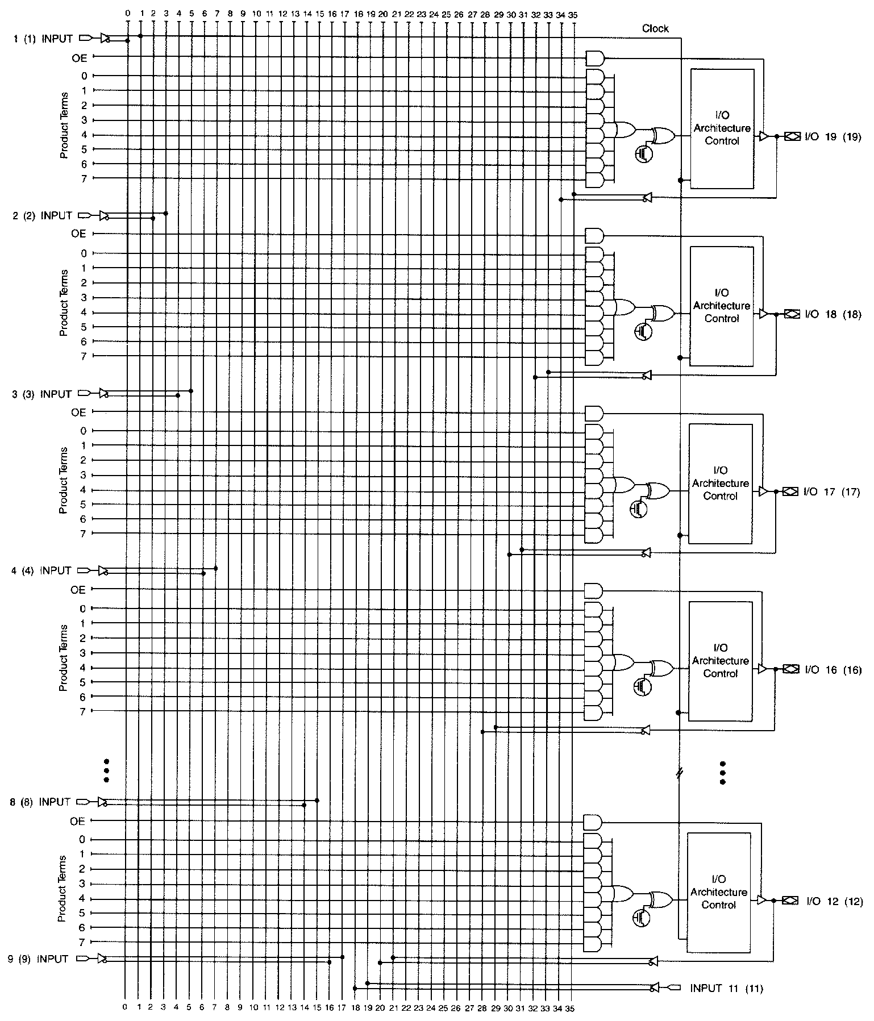
EPLD Block Diagram
Primary inputs
Macrocell
Courtesy Altera Corp.

Slide 29
Field-Programmable Gate Arrays Fuse-based
Standard-cell like
floorplan

Slide 30
Interconnect
Programming interconnect using anti-fuses

Slide 31
Field-Programmable Gate Arrays RAM-based

Slide 32
RAM-based FPGA Basic Cell (CLB)
Courtesy of Xilinx

Slide 33
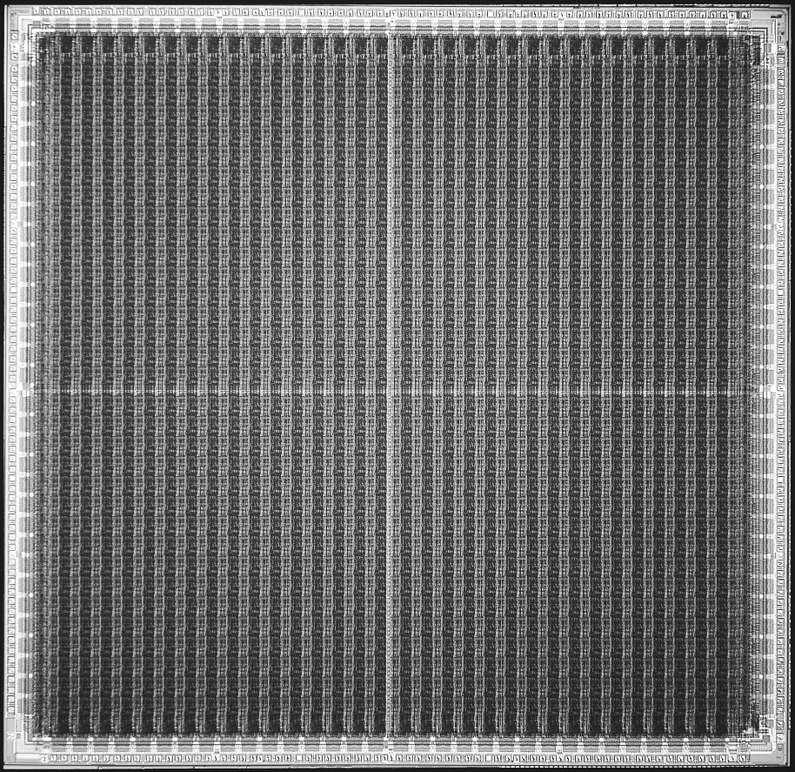
RAM-based FPGA
Xilinx XC4025

Slide 34
Taxonomy of Synthesis Tasks

